Slide 1
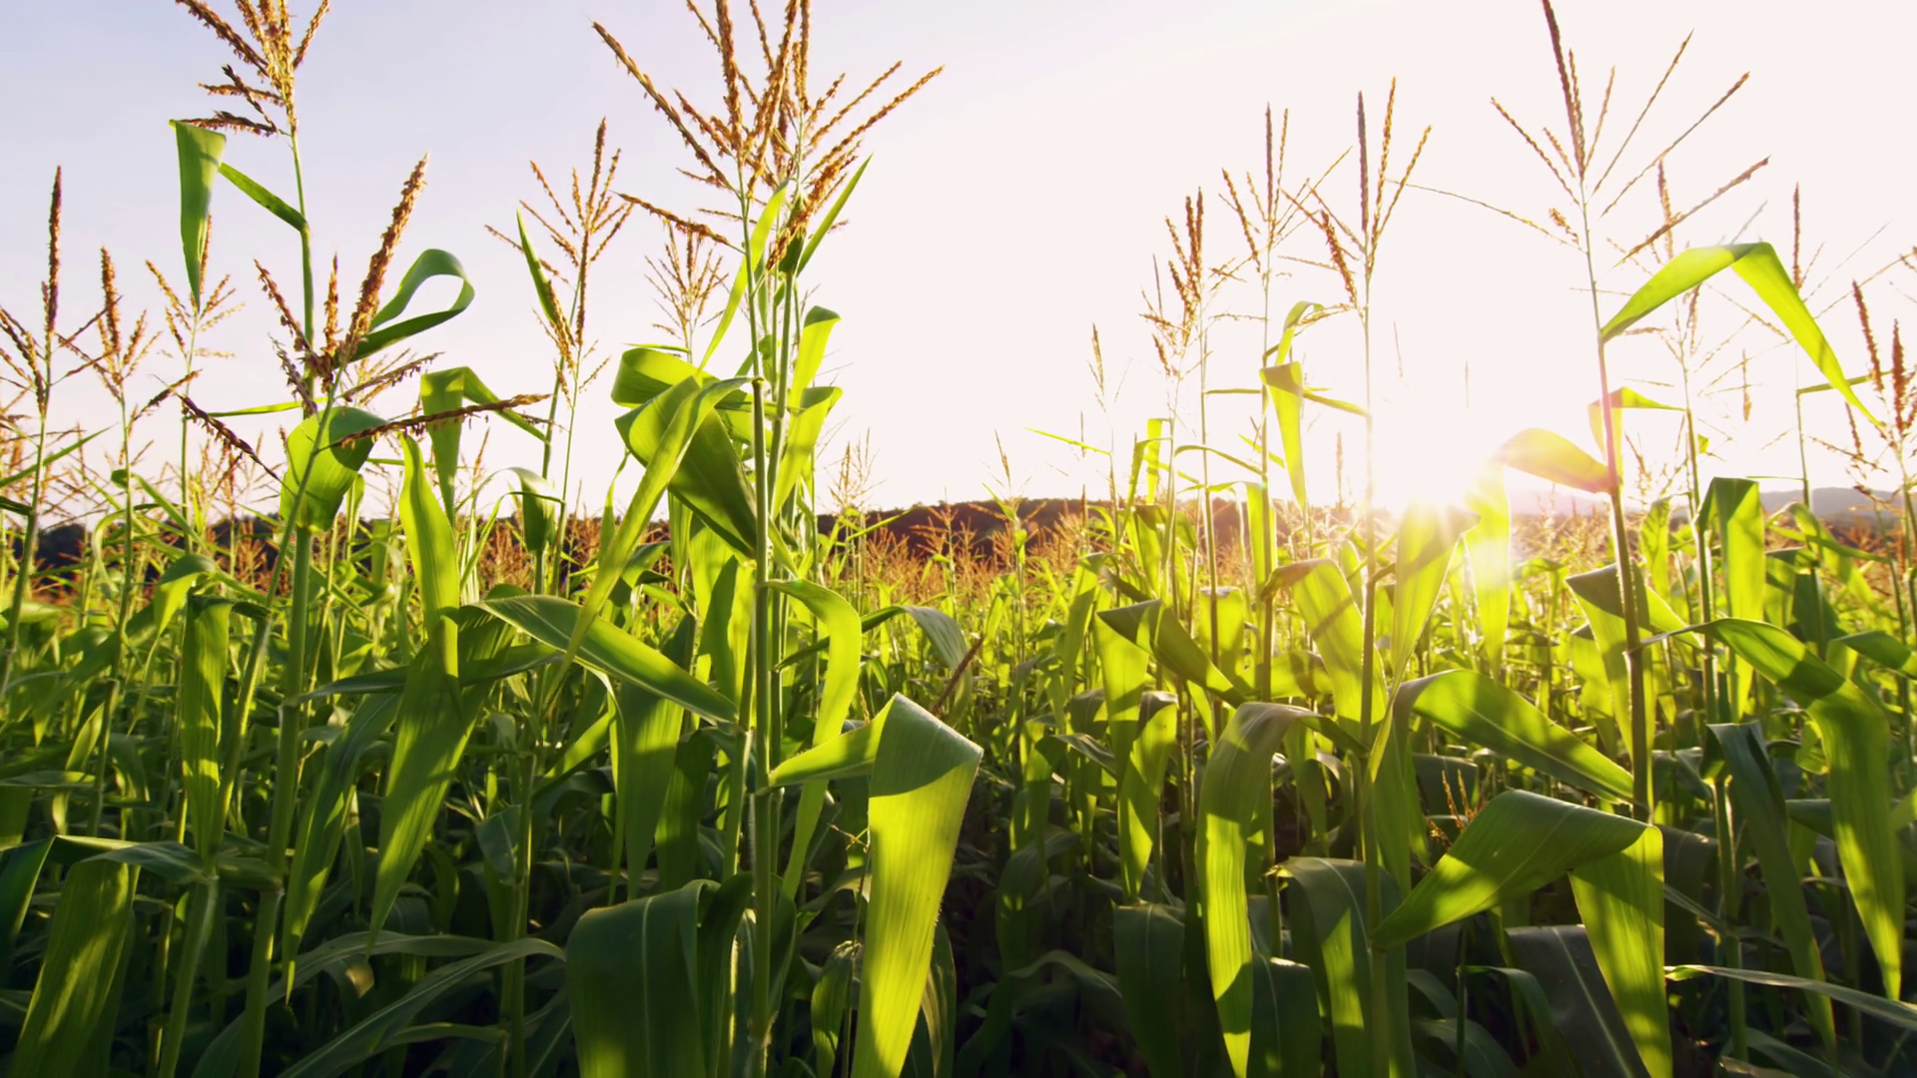
Balanced scorecard slide 1
Using Drone in Agriculture
Crop Disease Prediction
By – Himanshu Yogi
TEAM-darkknight

Slide 2
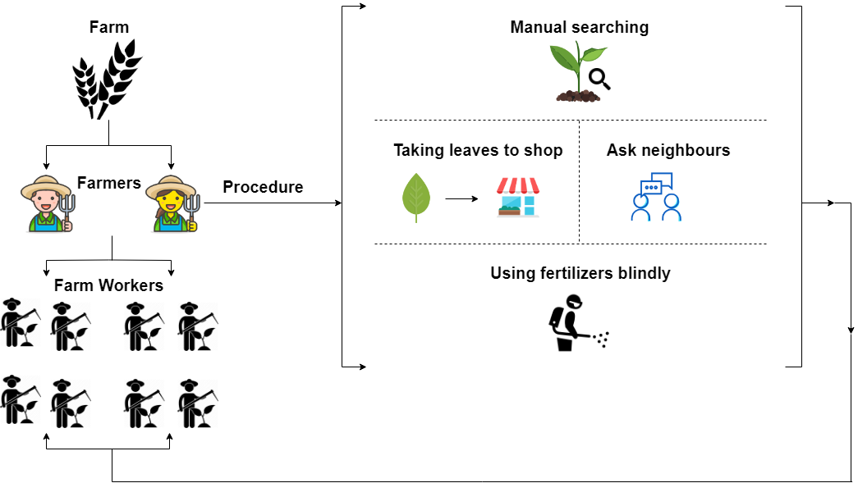

Balanced scorecard slide 2
Ecosystem of Farmers

Slide 3
Balanced scorecard slide 3
Needs of Farmers
More yield from crops
Crop disease detection
Solution for a specific disease from a trusted source
Alerts for safety Precautions
Proper guidance for farmers in future

Slide 4
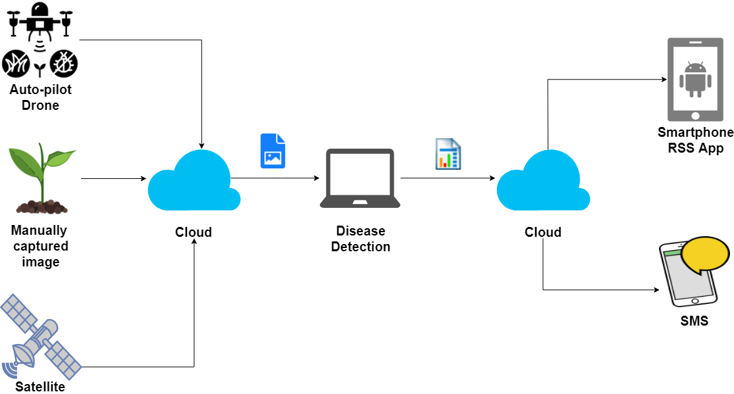
Balanced scorecard slide 3
Mechanism

Slide 5
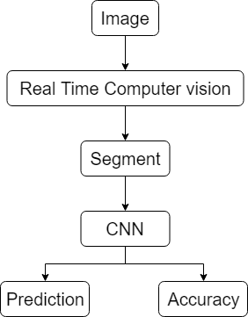
Balanced scorecard slide 3
Proposed Solution

Slide 6
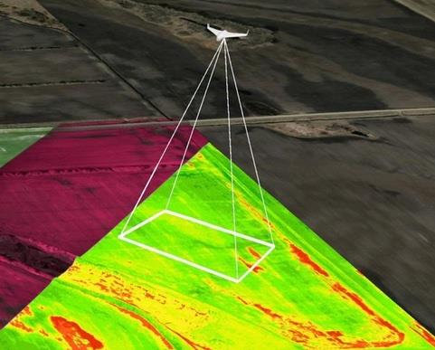
Balanced scorecard slide 3
Auto-pilot Drone

Slide 7
Balanced scorecard slide 3
Disease Detection
Train a CNN on different categories of datasets
Using keras with tensorflow backend(deep learning) to get more accurate predictions

Slide 8
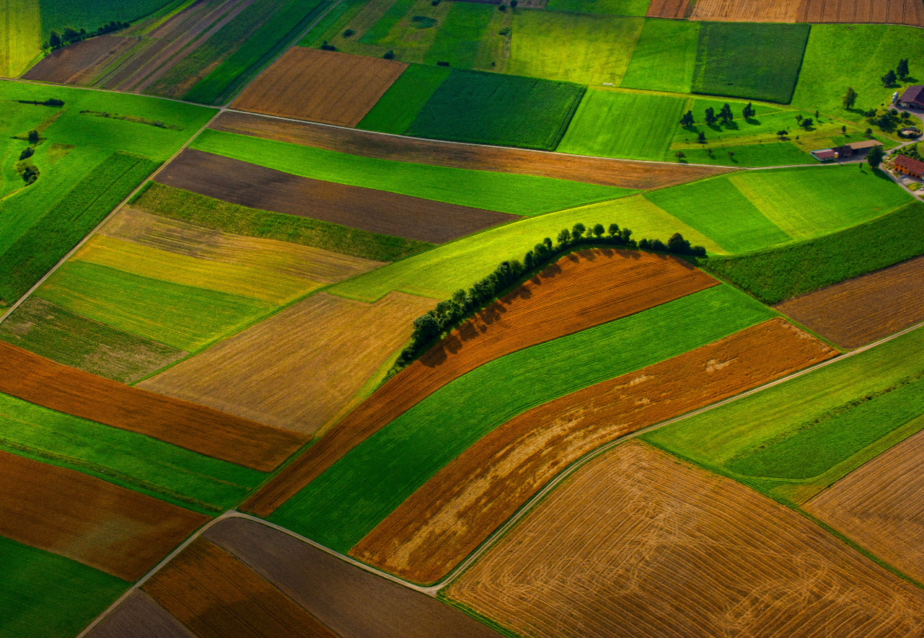
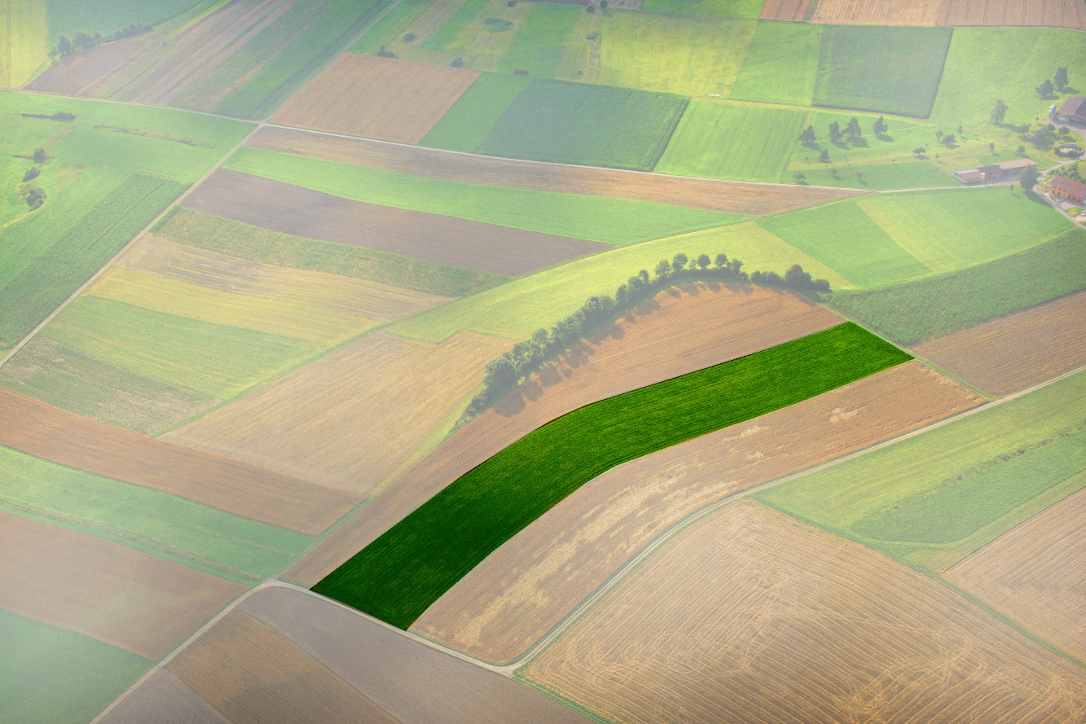
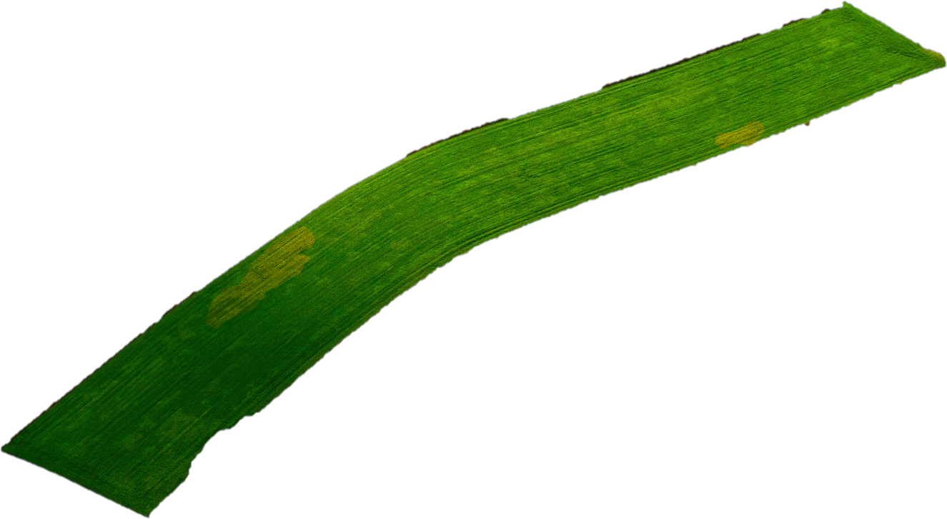
Balanced scorecard slide 3
Selecting the field

Slide 9
Balanced scorecard slide 3
Semantic Segmentation
Classification
2. Localization/Detection
3. Inference prediction

Slide 10
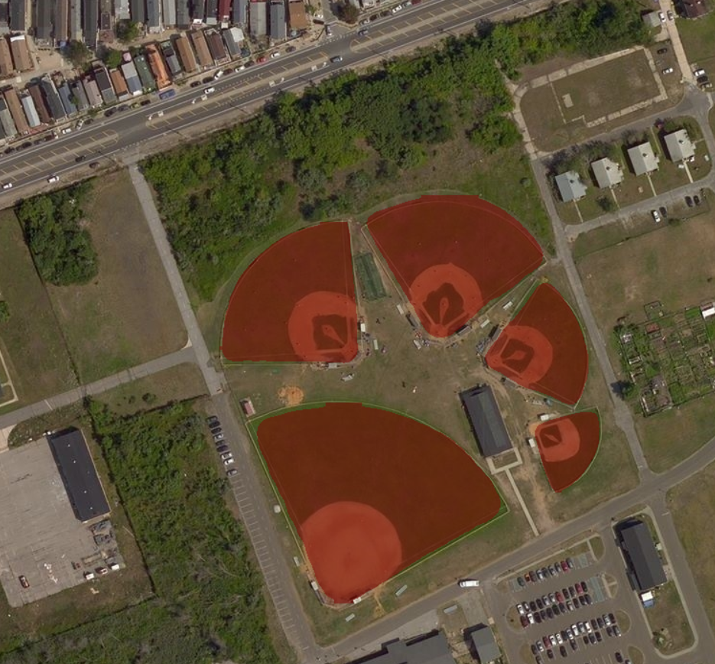
Balanced scorecard slide 3
Segmentation

Slide 11
Balanced scorecard slide 3
Android Application
Real-time alerts
Multimedia support
Solution product link
Guidance from expert

Slide 12
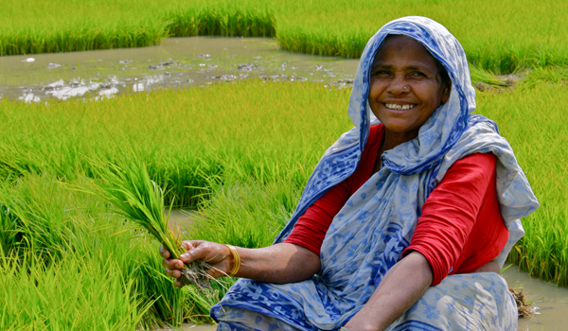
Balanced scorecard slide 3
Vision
Collecting the data of the yield from the crops timely to analyse the impact of our solution
To get better results in farming using technology

Slide 13
Balanced scorecard slide 3
Conclusion
Crop disease detection using drone
Possibility to increase the crop production
Good soil health for good production
Weather prediction and requirement of the crop
Solution for warning from wild animals

Slide 14
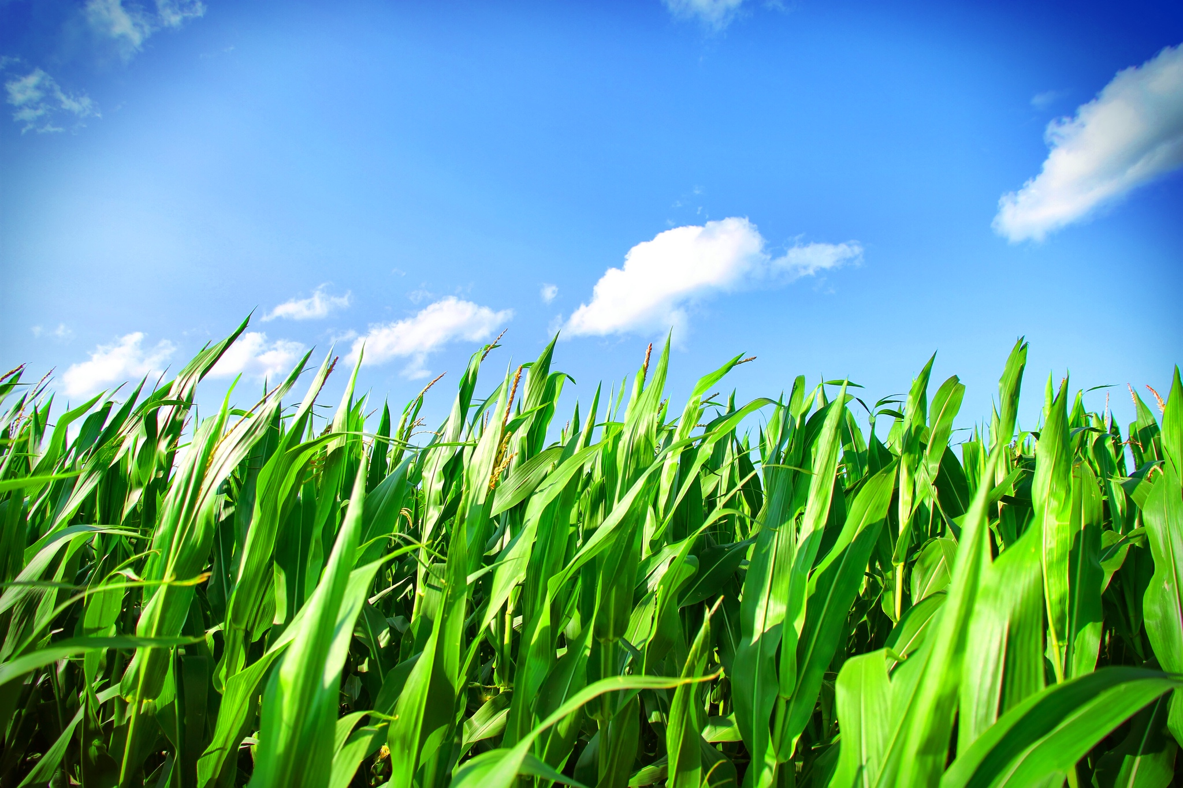
Balanced scorecard slide 10
THANK YOU

